Slide 1
Wireless Security

Slide 2
Why is Security More of a Concern in Wireless?
No inherent physical protection
  physical connections between devices are replaced by logical associations
  sending and receiving messages do not need physical access to the network infrastructure (cables, hubs, routers, etc.)
Broadcast communications
  wireless usually means radio, which has a broadcast nature
  transmissions can be overheard by anyone in range
  anyone can generate transmissions, which will be received by other devices in range
  which will interfere with other nearby transmissions and may prevent their correct reception (jamming)
Eavesdropping is easy
Injecting bogus messages into the network is easy
Replaying previously recorded messages is easy
Illegitimate access to the network and its services is easy
Denial of service is easily achieved by jamming

Slide 3
Overview
Defend
Detect
Attacks
Understand Attacks

Slide 4
Attacking Wireless Networks

Slide 5
Attack 1: CSMA Selfish Behaviors
Carrier sense: When a node wishes to transmit a packet, it first waits until the channel is idle
Backoff Interval: used to reduce collision probability
When transmitting a packet, choose a backoff interval in the range [0,cw]: cw is contention window
Count down the backoff interval when medium is idle
  Count-down is suspended if medium becomes busy
When backoff interval reaches 0, transmit
IEEE 802.11 DCF: contention window cw is chosen dynamically depending on collision occurrence

Slide 6
Binary Exponential Backoff
When a node faced a transmission failure, it increases the contention window
  cw is doubled (up to an upper bound)
When a node successfully completes a data transfer, it restores cw to Cwmin
cw follows a sawtooth curve

Slide 7
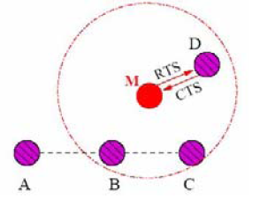
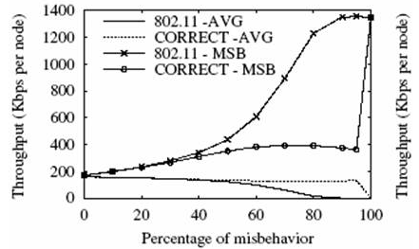
Attack 1: CSMA Selfish Behaviors
Use smaller backoff window
  Transmit with you should not
    Attacker gets more bandwidth
  Cause collisions to others
Notes:
Figures from “Overcoming Misbehavior in Mobile Ad Hoc Networks: An Overview.”

Slide 8

Attack 2: Jamming
jammer
I can’t decode my data

Slide 9
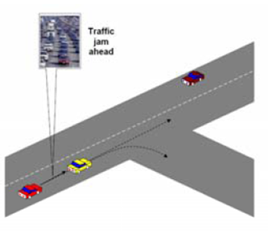
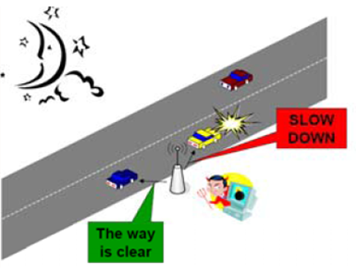
Attack 3: Injecting Bogus Information

Slide 10
Introduction
Traditionally, Denial of Service (DoS) attacks involve filling receiving buffers and/or bringing down servers
In the wireless domain, DoS is more fundamentally linked with the medium
  MAC misbehavior or
  Preventing nodes from even communicating (i.e., jamming)

Slide 11
Roadmap
Jamming Models
Basic Detection Mechanisms
Advanced Detection Mechanisms

Slide 12
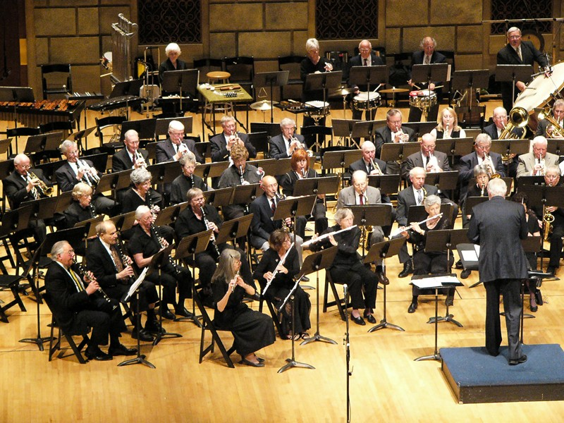

What is a Jammer?
A jammer is purposefully trying to interfere with the physical transmit/receive

Slide 13
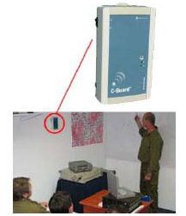
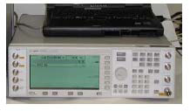
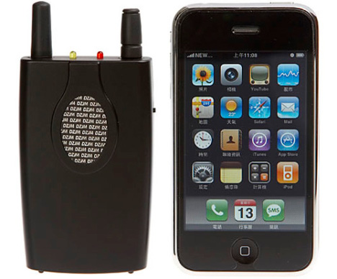
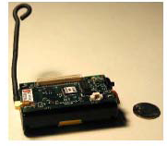
Jammers -- Hardware
Cell phone jammer unit
  Block every cellular phone!!!
Signal generator
Conventional devices

Slide 14
Goal of Jammer
Interference
  Prevent a sender from sensing out packets
  Prevent a receiver from receiving legitimate packets
How to measure their effectiveness:
  Packet Send Ratio (PSR):
    Ratio of actual # of packets sent out versus # of packets intended
  Packet Delivery Ratio (PDR):
    Ratio of # of successfully delivered packets versus # of packets sent out
    Measured at sender [ACKs] or receiver [CRC check]

Slide 15
Jammer Attack Models
Normal MAC protocol:
Jammer:
Need to
send m
Need to
send m
Is
channel
idle?
Is
channel
idle?
No
No
Backoff
Backoff
Yes
Yes
start to
send m
start to
send m

Slide 16
Jamming Models
Constant Jammer
  Continuously emits radio signal (random bits, no MAC-etiquette)
Deceptive Jammer
  Continuously sends regular packets (preamble bits) without gaps in transmission
  Targeting sending
Random Jammer
  Alternates between sleeping and jamming states.
  Takes energy conservation into consideration
Reactive Jammer:
  Reacts to a sent message
  Targeting reception;
  Harder to detect

Slide 17
Constant Jammer
Constant Jammer - continually emits a radio signal (noise). The device will not wait for the channel to be idle before transmitting. Can disrupt even signal strength comparison protocols .

Slide 18
Deceptive Jammer
Deceptive Jammer - constantly injects regular packets with no gap between packets. A normal device will remain in the receive state and cannot switch to the send state because of the constant stream of incoming packets.

Slide 19
Random Jammer
Random Jammer - alternates between sleeping and jamming. Can act as constant or deceptive when jamming. Takes energy conservation into consideration.

Slide 20
Reactive Jammer
Reactive Jammer - other three are active this is not. It stays quiet until there is activity on the channel. This targets the reception of a message. This style does not conserve energy however it may be harder to detect.

Slide 21
Basic Jamming Detection
What attributes will help us detect jamming?
Signal strength (PHY-layer detection)
Carrier sense (MAC layer detection)
Packet Delivery Ratio
  Detects all jamming models
  Differentiates jamming from congestion
  Cannot differentiate jamming from node failure, battery loss, departure, etc.

Slide 22
Detection 1: Analyzing Signal Strength
How can we use Signal Strength to detect Jamming?
Signal strength distribution may be affected by the presence of a jammer
Each device should gather its own statistics to make its own decisions on the possibility of jamming
Establish a base line or build a statistical model of normal energy levels prior to jamming of noise levels….But how??

Slide 23
Two Methods for Signal Strength
1. Basic Average and Energy Detection
  We can extract two statistics from this reading, the average signal strength and the energy for detection over a period of time
2. Signal Strength Spectral Discrimination
  A method that employs higher order crossings (HOC) to calculate the differences between samples
  This method is practical to implement on resource constrained wireless devices, such as sensor nodes

Slide 24
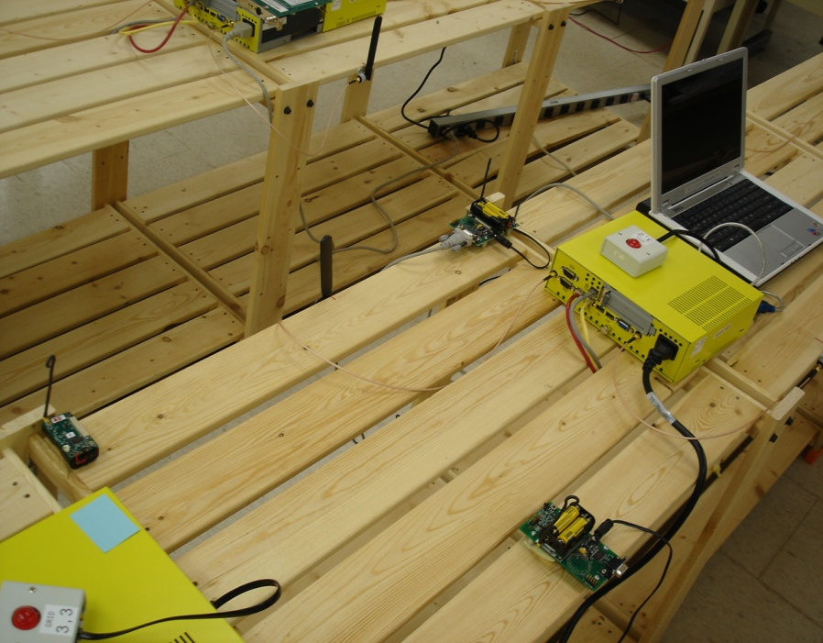
Experiment Setup
Involving three parties:
  Normal nodes:
    Sender A
    Receiver B
  Jammer X
Parameters
  Four jammers model
  Distance
    Let d_{XB} = d_{XA}
    Fix d_{AB} at 30 inches
  Power
    P_{A} = P_{B} = P _{X} = -4dBm
Receiver B
Sender A
d_{AB}
d_{XB}
d_{XA}
Jammer X

Slide 25
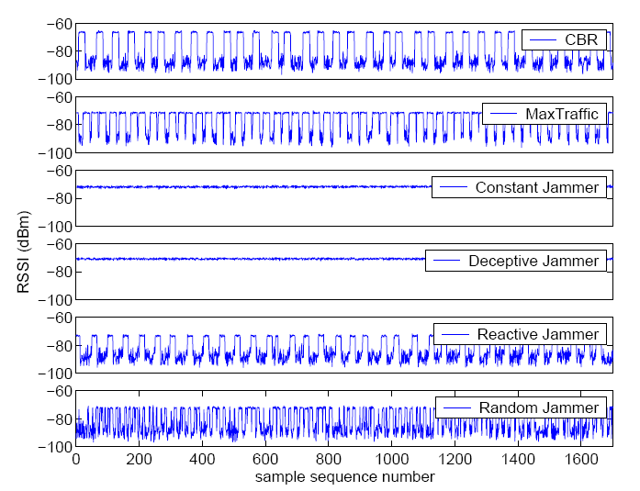
Signal Strength
CBR: 20 packets per second
The average values for the constant jammer and the MaxTraffic source are roughly equal
The constant jammer and deceptive jammer have roughly the same average values
The signal strength average from a CBR source does not differ much from the reactive jammer scenario
These results suggest that we may not be able to use simple statistics such as average signal strength to identify jamming

Slide 26
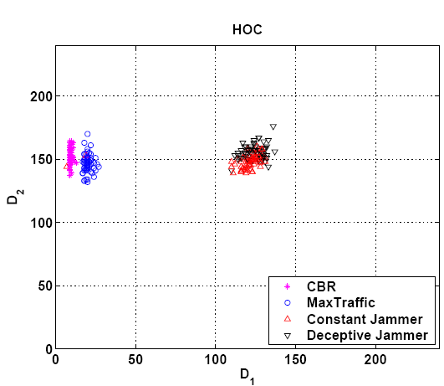
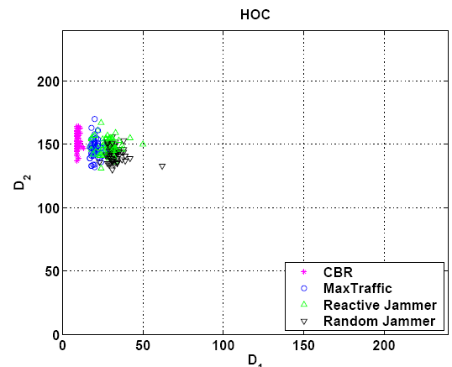
Signal-Strength: Higher Order Crossing
We can not distinguish the reactive or random jammer from normal traffic
A reactive or random jammer will alternate between busy and idle in the same way as normal traffic behaves
HOC will work for some jammer scenarios but are not powerful enough to detect all jammer scenarios
Not working well….

Slide 27
Detection 2: Analyzing Carrier Sensing Time
A jammer can prevent a legitimate source from sending out packets ⬅ channel might appear constantly busy to the source
Keep track of the amount of time it spends waiting for the channel to become idle (carrier sensing time)
  Compare it with the sensing time during normal traffic operations to determine whether it is jammed
  Only true if MAC protocol employs a fixed signal strength threshold to determine whether channel is busy
Determine when large sensing times are results of jamming by setting a threshold
Threshold set conservatively to reduce false positive

Slide 28
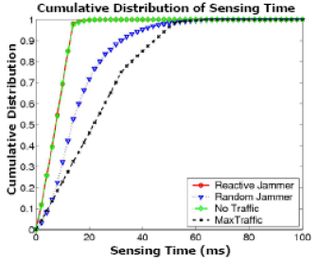
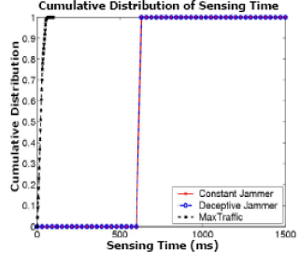

Detection 2: Analyzing Carrier Sensing Time
It detects the Constant and Deceptive Jammer
Hard to detect a reactive jammer

Slide 29
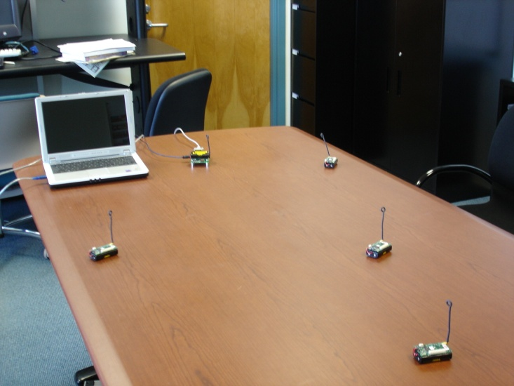
Detection 3: Analyzing Packet Delivery Ratio
How much PDR degradation can be caused by non-jamming, normal network dynamics, such as congestion? (PDR 78%)
A jammer causes the PDR drop significantly, almost to 100%
A simple threshold based on PDR is a powerful statistic to determine Jamming vs. congestion
PDR can not differentiate non-aggressive jamming attacks from poor channel quality…
Receiver
MaxTraffic
Sender

Slide 30
Basic Statistics Summary
Both Signal Strength and Carrier Sensing time can only detect the constant and deceptive jammer
Neither of these two statistics is effective in detecting the random or the reactive jammer
PDR is a powerful statistic to determine Jamming vs. congestion
  It can not account for all network dynamics

Slide 31
Solution: Consistency Checks
PDR is relatively good
  Normal scenario:
    High signal strength → high PDR
    Low signal strength → low PDR
  Low PDR in real life
    Poor channel quality
    Jamming attacks → high signal strength
Consistency check
  Look at transmissions from neighbors
  If at least one neighbor has high PDR
  If all have low PDR → check signal strength → high → I am being jammed!

Slide 32
Location-Based Consistency Check
Concept:
  Close neighbor nodes → high PDR
  Far neighbor nodes → lower PDR
If all nearby neighbors exhibit low PDR
→ jammed!

Slide 33
PRD/Signal Strength Consistency
PDR< Threshold
No
Yes
Sample Signal Strength
Not Jammed
PDR consistent with SS
Yes
No
Jammed

Slide 34
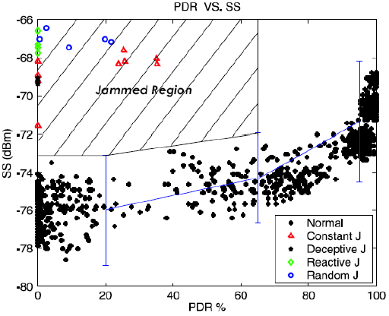
Results
Observed Normal relationships
    High signal strength yields a high PDR
    Low signal strength yields a low PDR
Jammed scenario: a high signal strength but a low PDR
The Jammed region has above 99% signal strength confidence intervals and whose PDR is below 65%

Slide 35
What Happens After Detection??
This work has identified jamming models and described a means of detection
Prevention? Reaction?
  Channel surfing and spatial retreats
  SSCH

Slide 36

Our Jammers
MAC-layer Jammer
  Mica2 Motes (UC Berkeley)
    8-bit CPU at 4MHz
    512KB flash, 4KB RAM
    916.7MHz radio
    OS: TinyOS
  Disable the CSMA
  Keep sending out the preamble
PHY-layer Jammer
  Waveform Generator
  Tune frequency to 916.7MHz

Slide 37

Escaping From Jamming Attacks
Channel Surfing
  Utilize frequency hopping if a node detects that it is being jammed it just switches to another channel
    Inspired by frequency hopping techniques, but operates at the link layer
  System Issues: Must have ability to choose multiple “orthogonal” channels
    Practical Issue: PHY specs do not necessarily translate into correct “orthogonal” channels
    Example: MICA2 Radio recommends: “choose separate channels with a minimum spacing of 150KHz” but…..

Slide 38
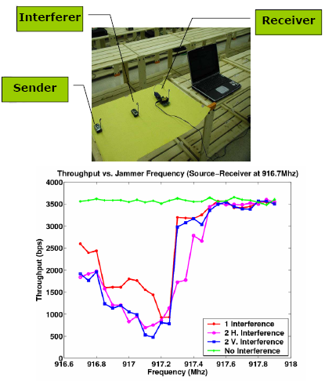
Throughput VS. Channel Assignment
Sender sends the packet as fast as it can
Receiver counts the packet and calculates the throughput
The radio frequency of the sender and receiver was fixed at 916.7MHz
Increased the interferer’s communication frequency by 50kHz each time
When the Jammer’s communication frequency increases to 917.5MHz, there is almost no interference

Slide 39
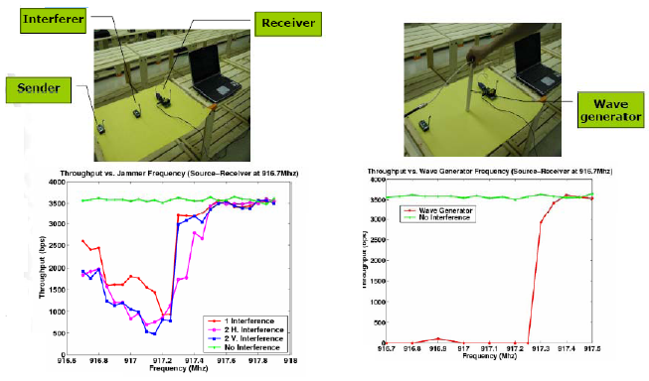
Is Channel Surfing Feasible??

Slide 40
Escaping From Jamming Attacks
“Orthogonal” channels
  The fact is that we need at least 800KHz to escape the interference
  Therefore, explicit determination of the amount of orthogonal channels is important
Channel Surfing
  Target: maximize the delay before the attacker finds the new channel
  Solution: use a (keyed) pseudo-random channel assignment between nodes

Slide 41
Escaping from Jamming Attacks
Spatial Retreats:
  If a node is jammed move spatially (physically) to another location
  When a node changes location, it needs to move to a new location where it can avoid being jammed but minimize network degradation
  Sometimes a spatial retreat will cause a network partition
Two different strategies to defend against jamming
  Channel-surfing: changing the transmission frequency to a range where there is no interference from the attacker
  Spatial retreat: moving to a new location where there is no interference

Slide 42
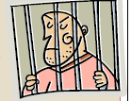
Jammers will be Punished
A man skilled in the operation of commercial wireless Internet networks was sentenced for intentionally bringing down wireless Internet services across the region of Vernal, Utah.
Ryan Fisher, 24, was sentenced to 24 months in prison to be followed by 36 months of supervised release, and to pay $65,000 in restitution.
In total, more than 170 customers lost Internet service, some of them for as long as three weeks

Slide 43
Bottom Line
Don’t be Evil !!

